Slide 1
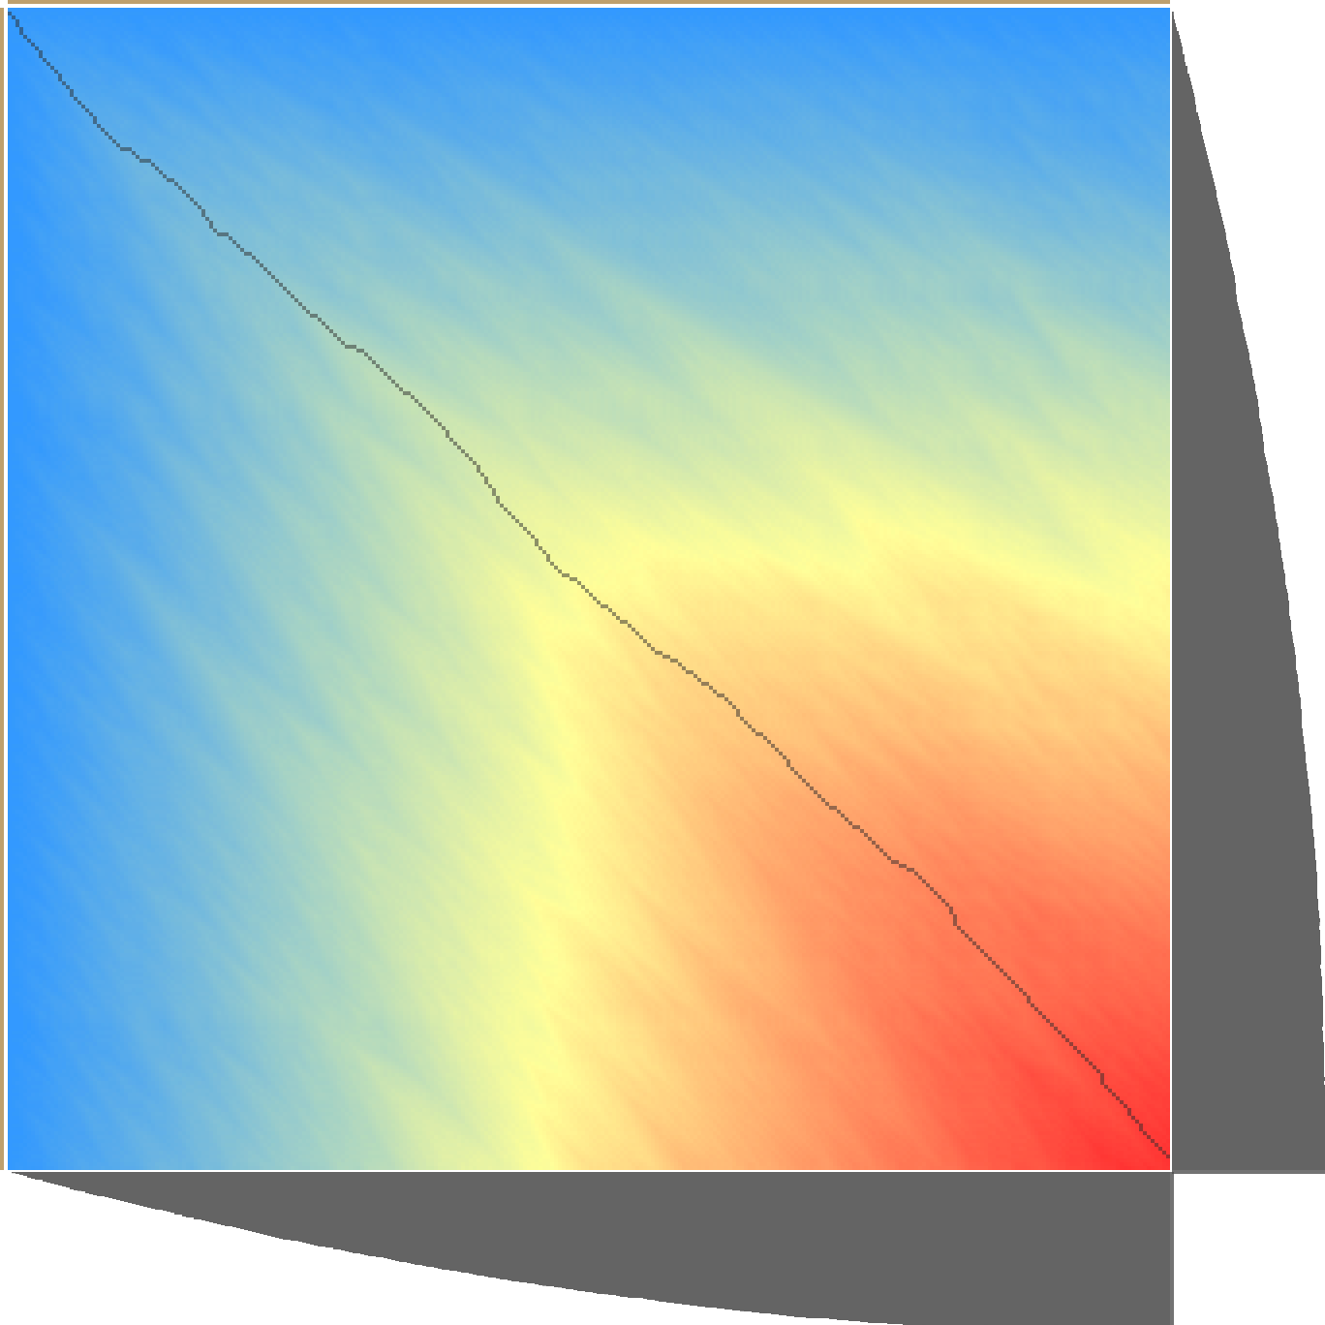
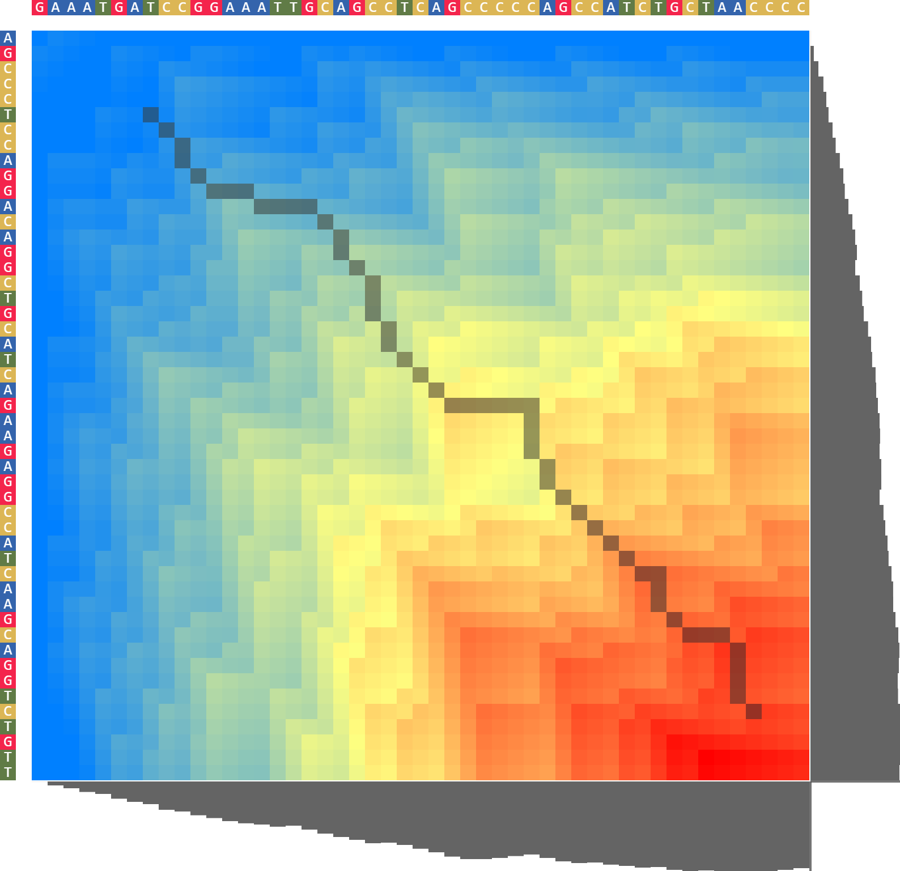
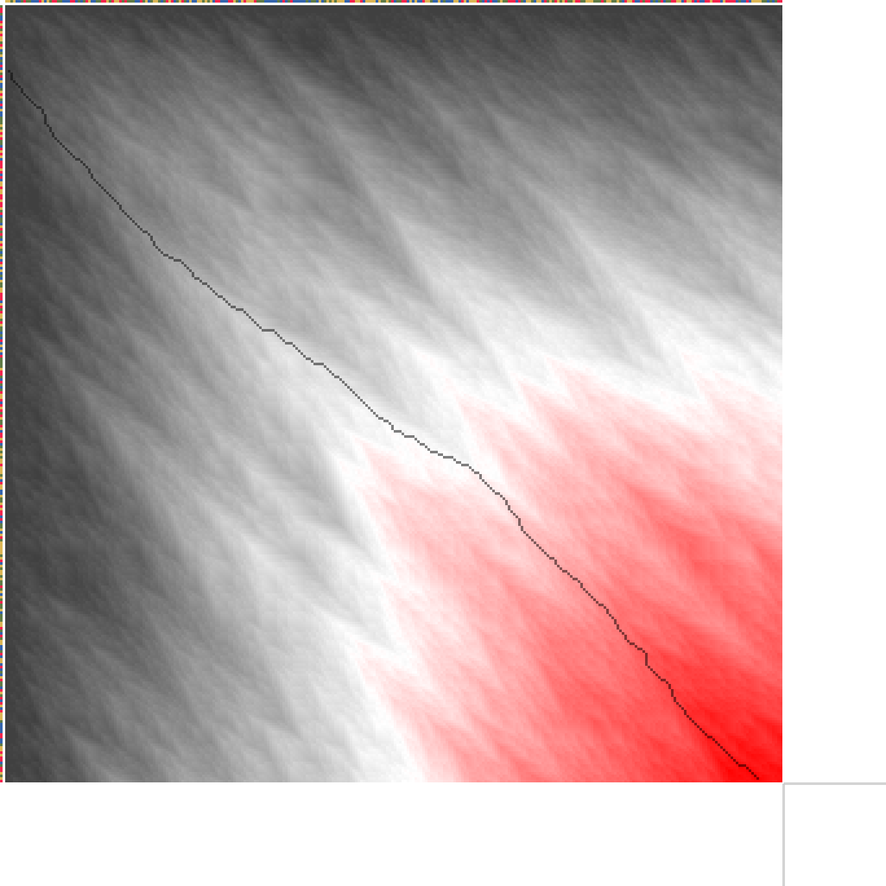
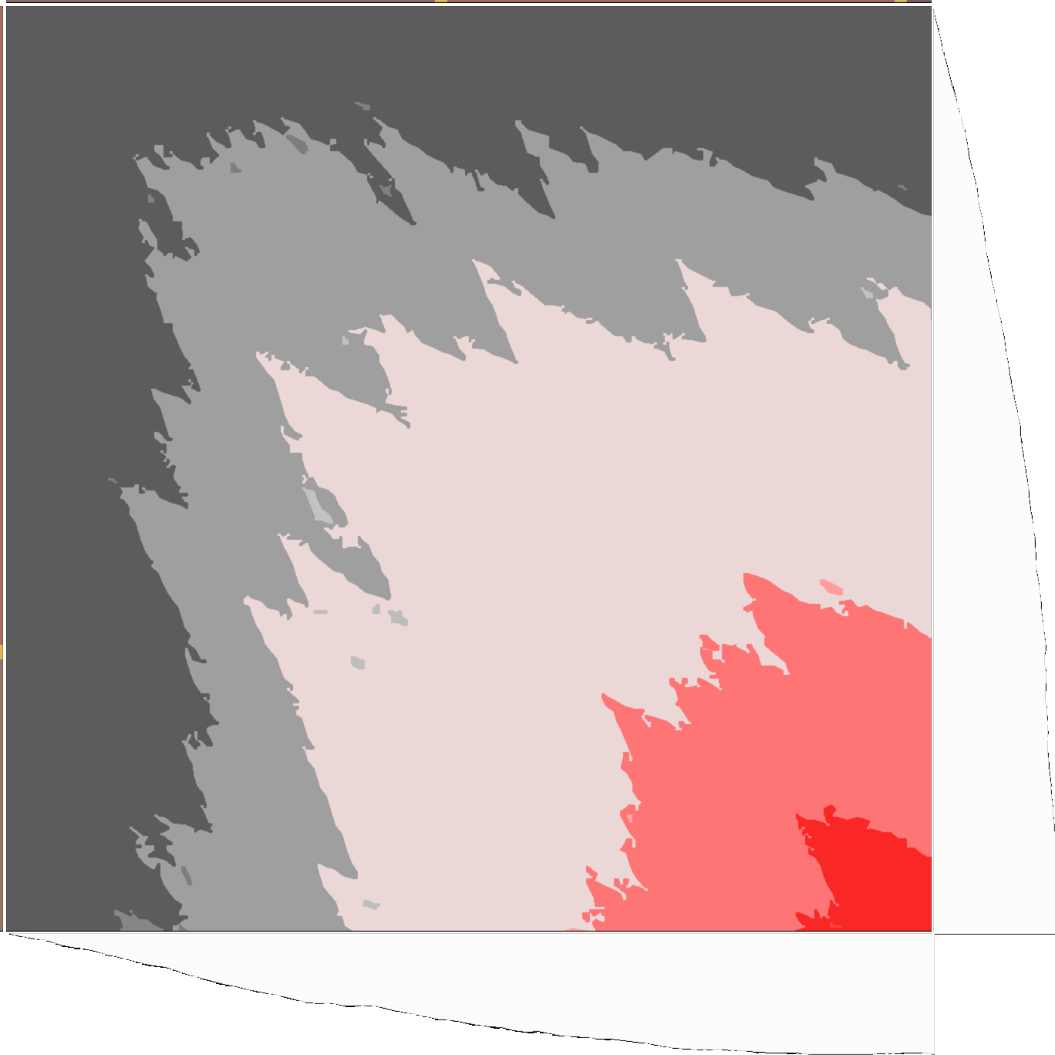
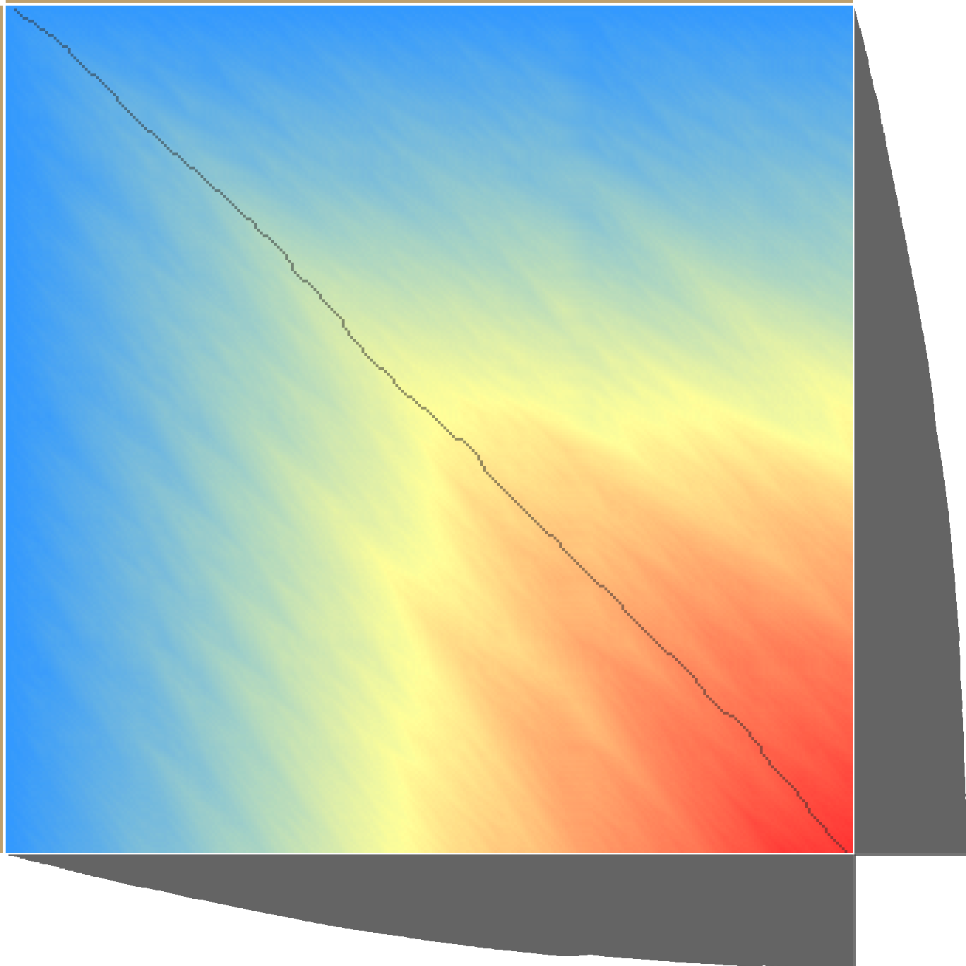
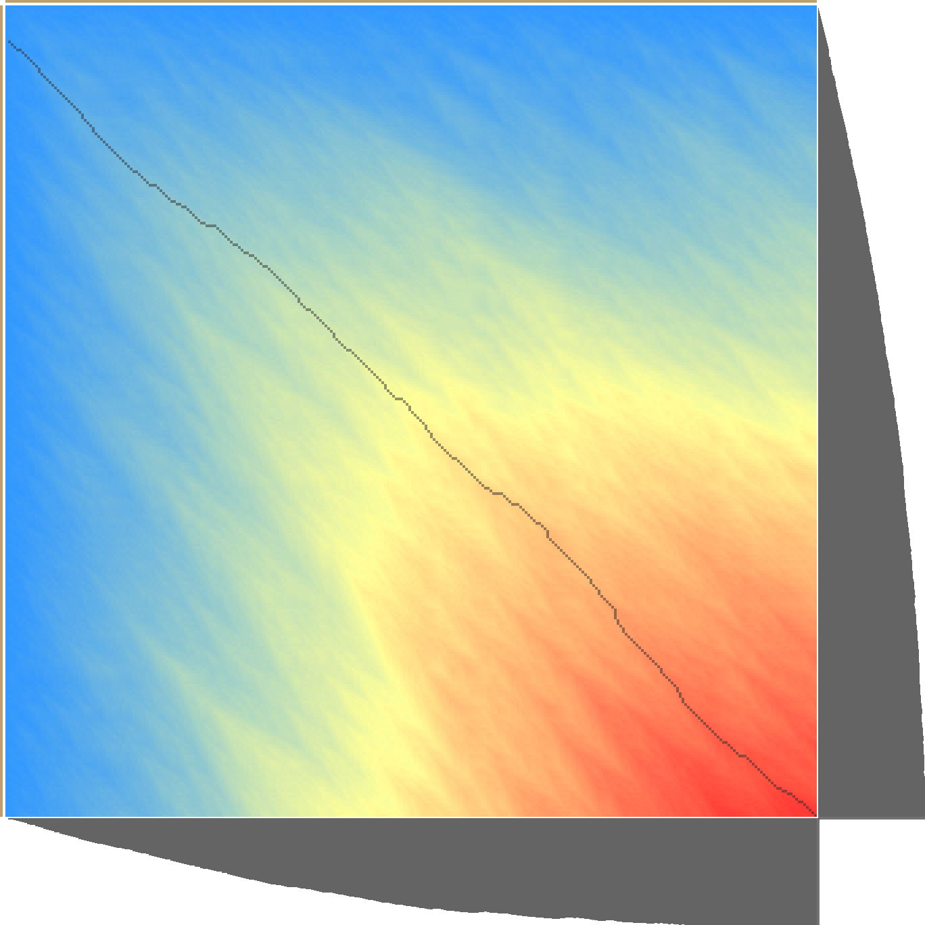
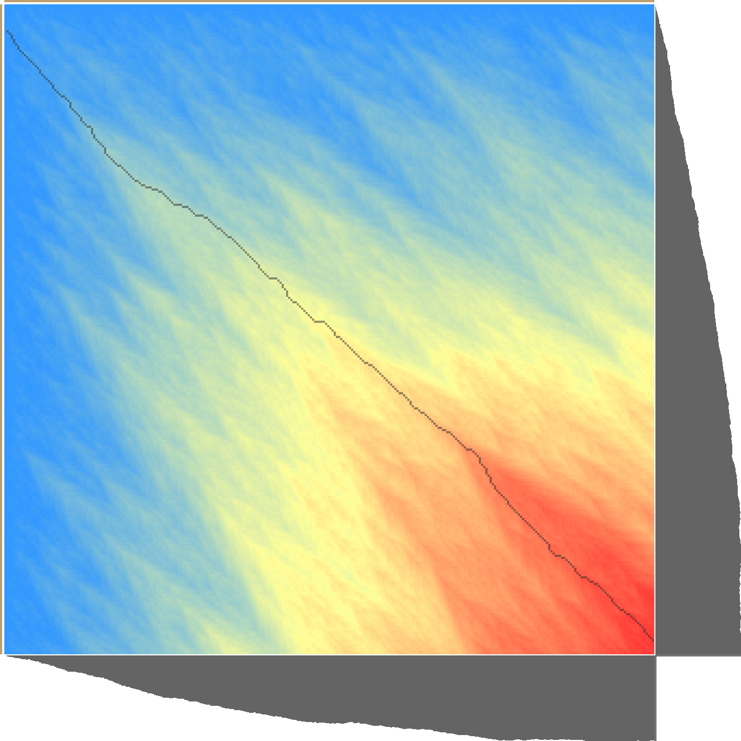
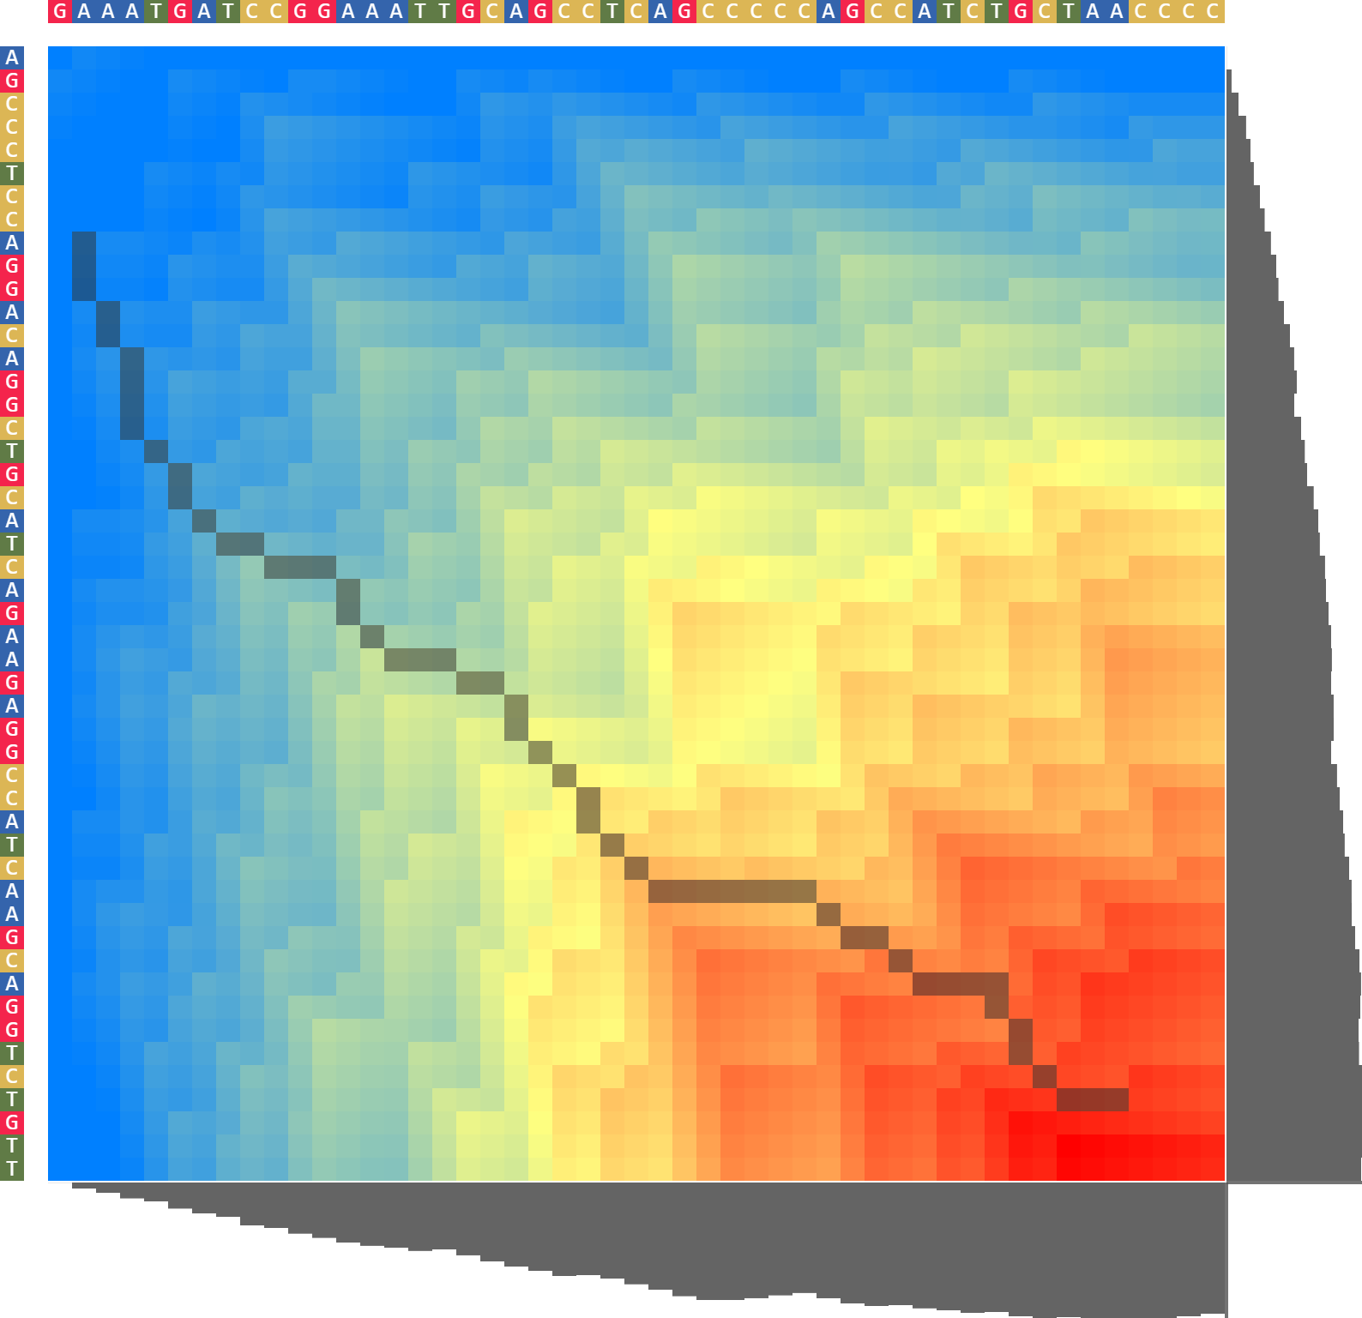
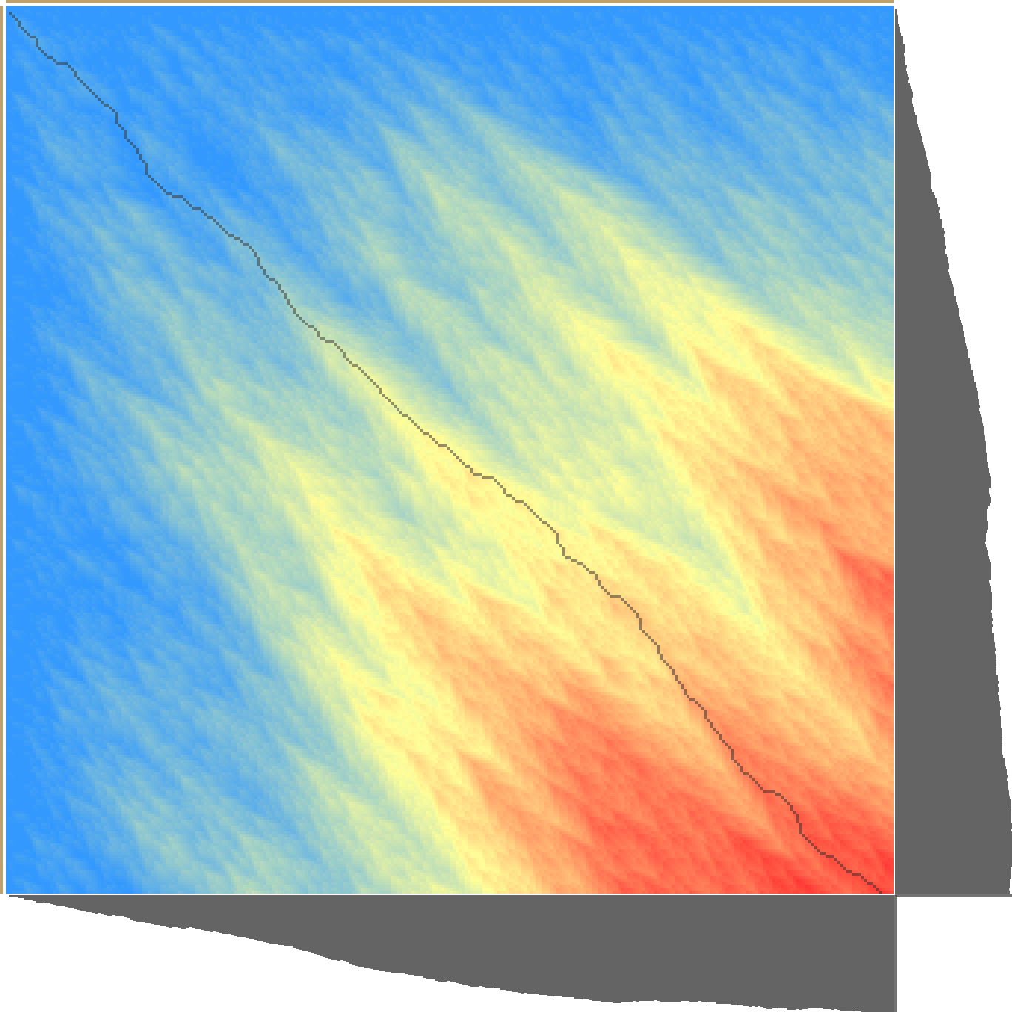
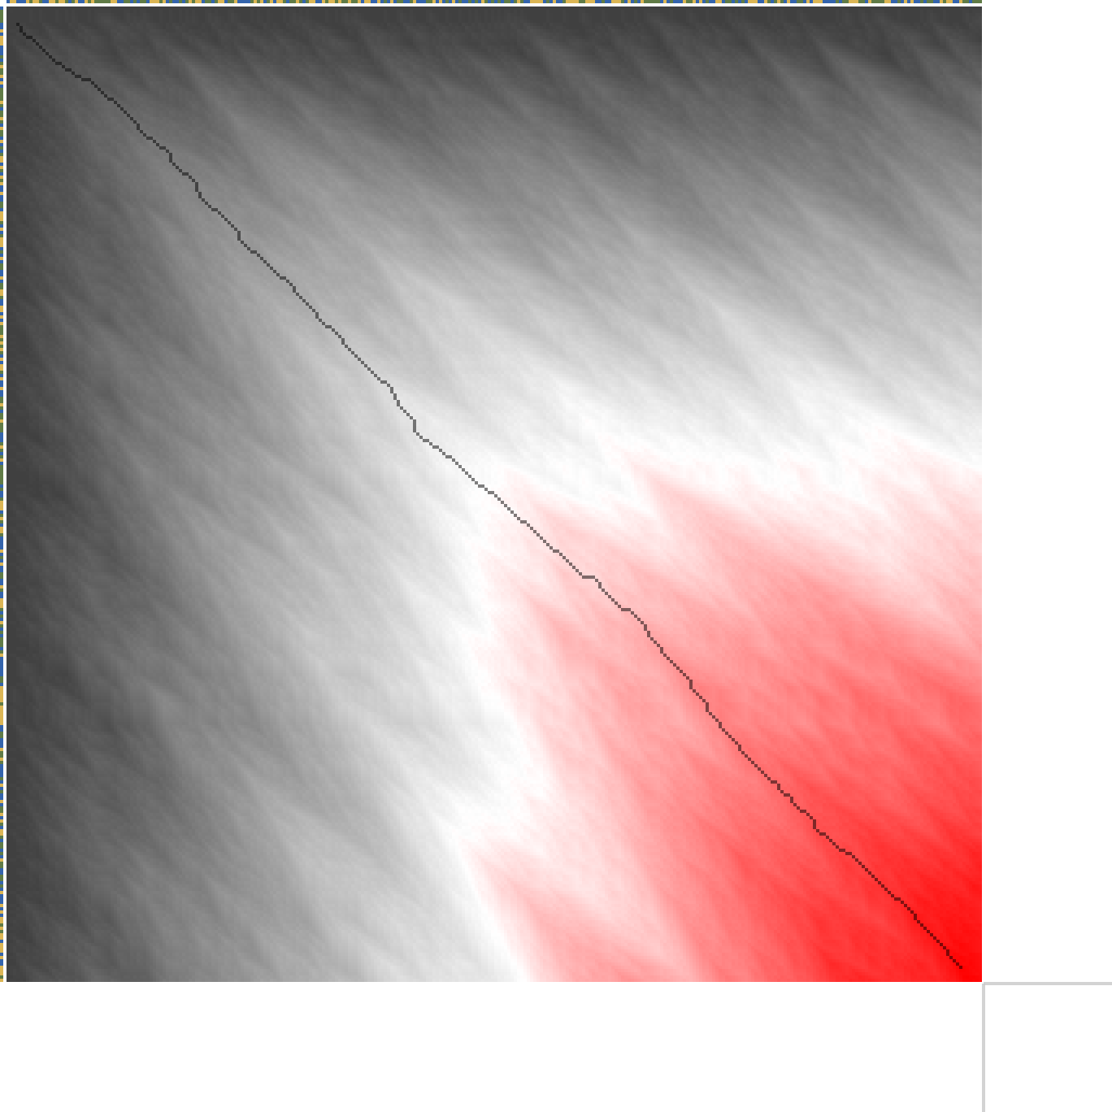
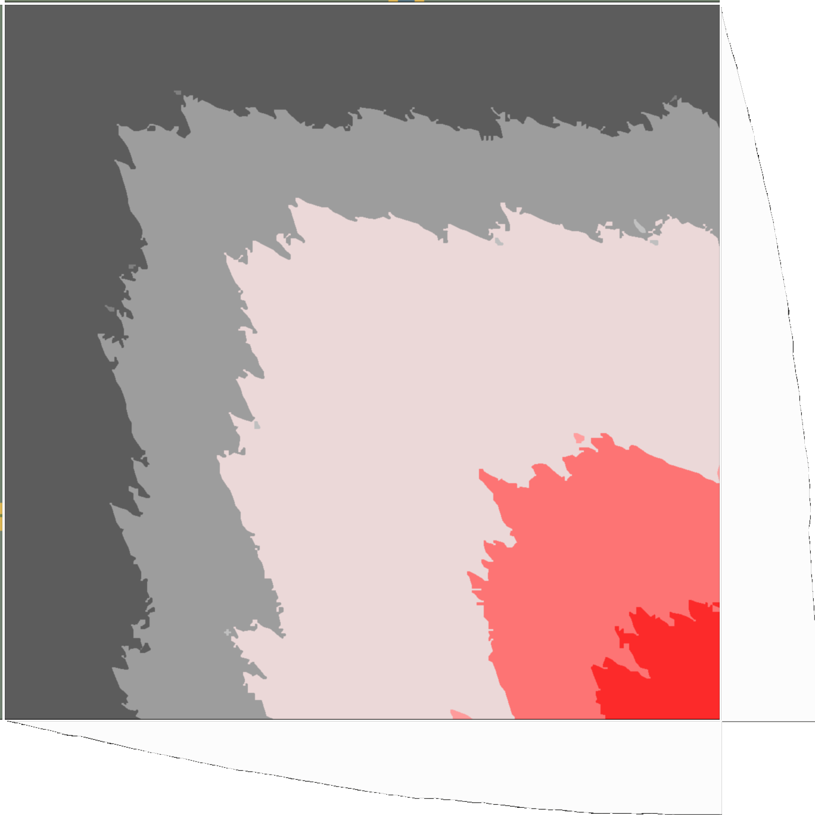
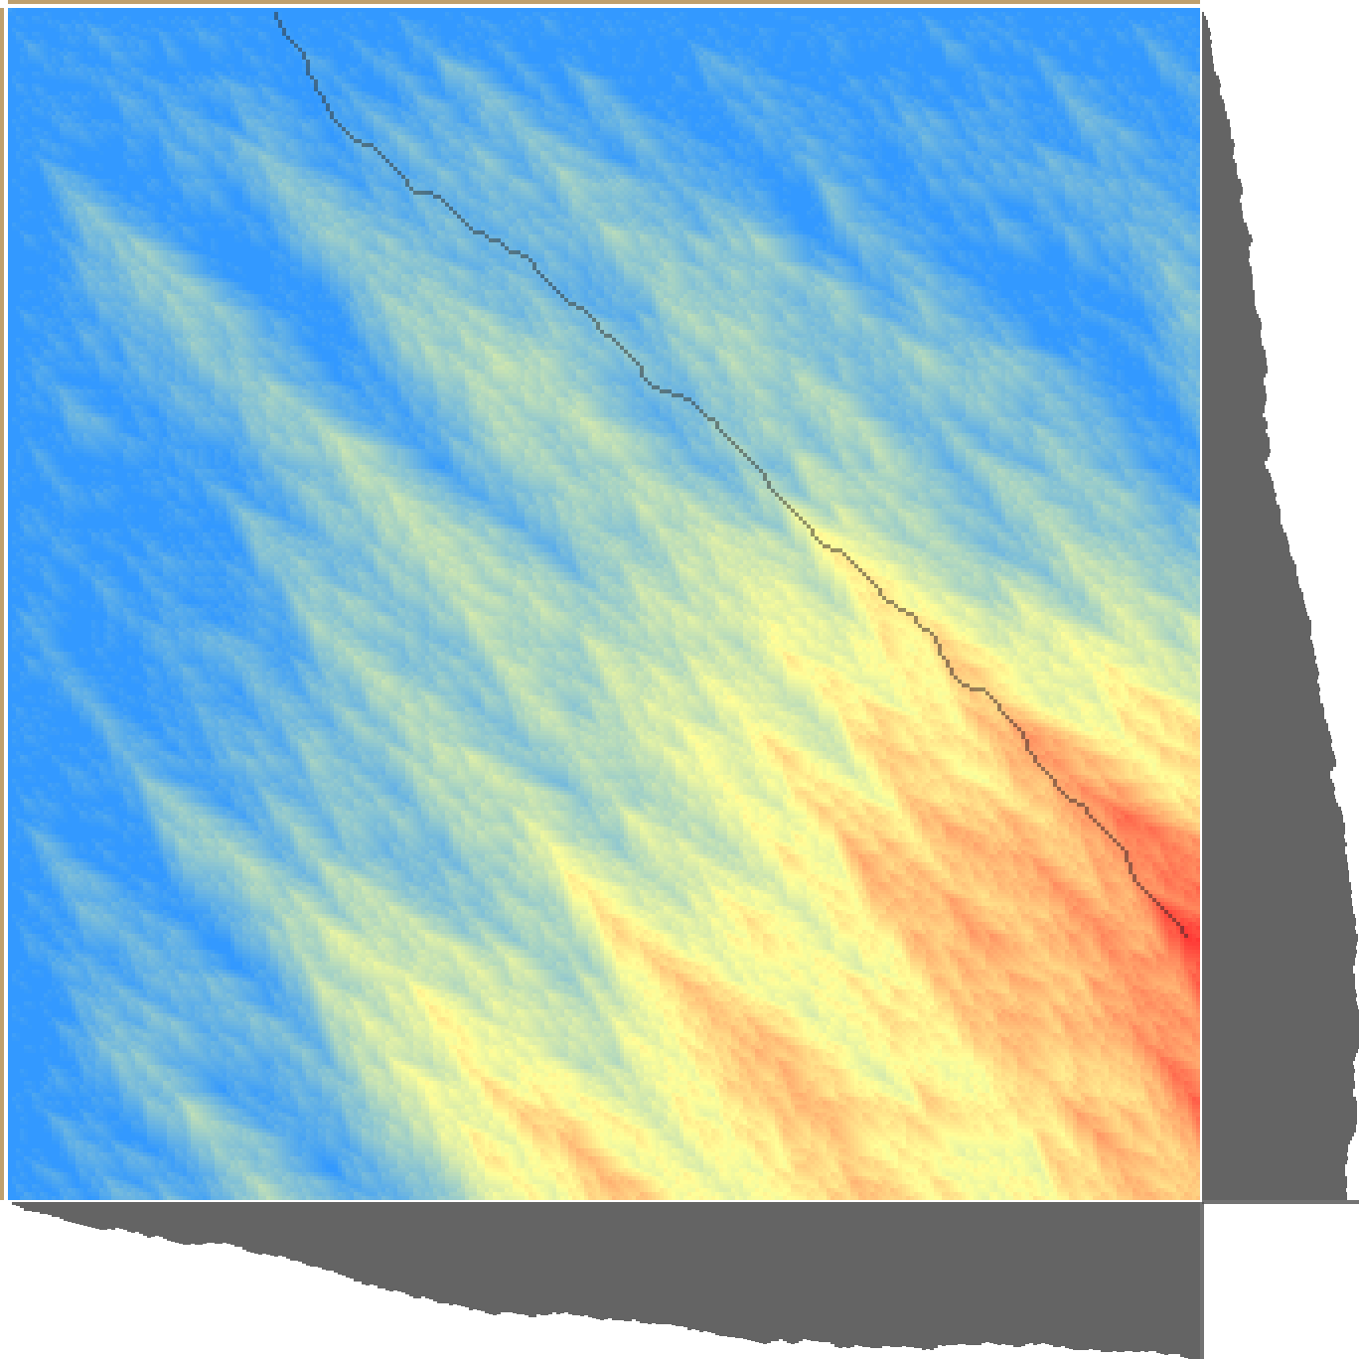
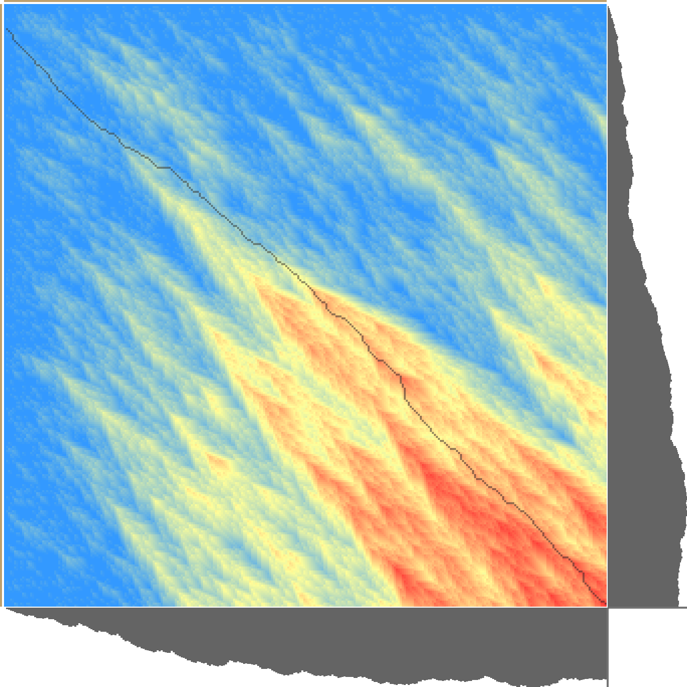
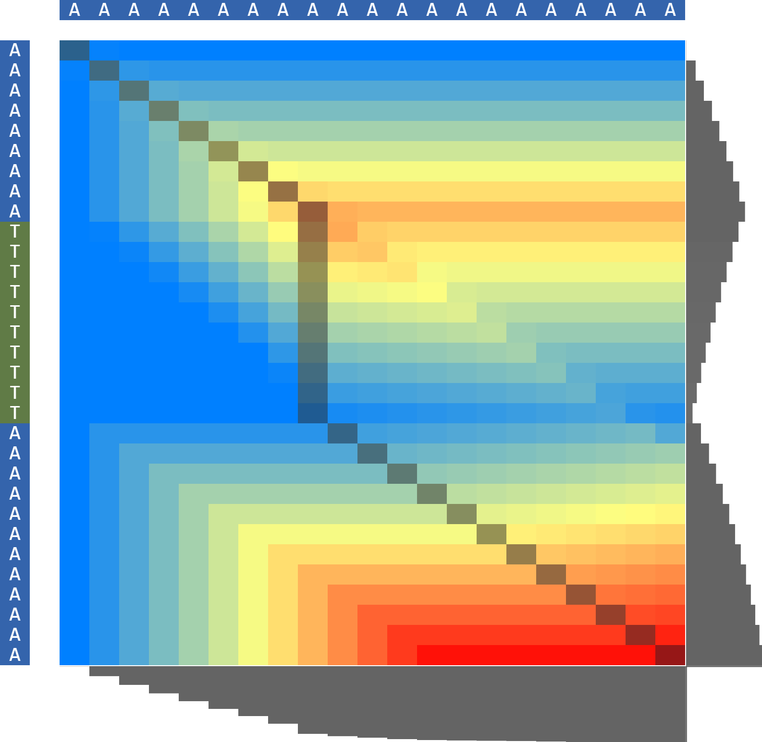
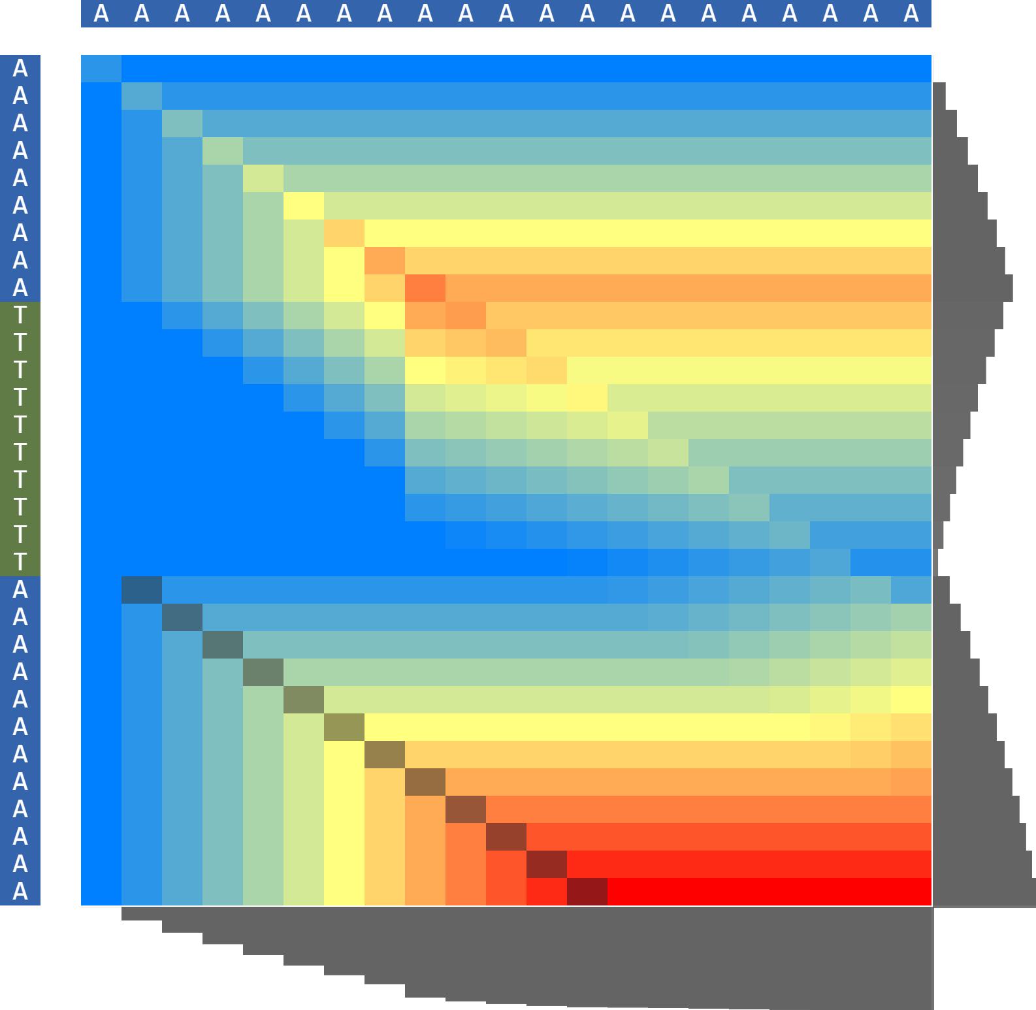
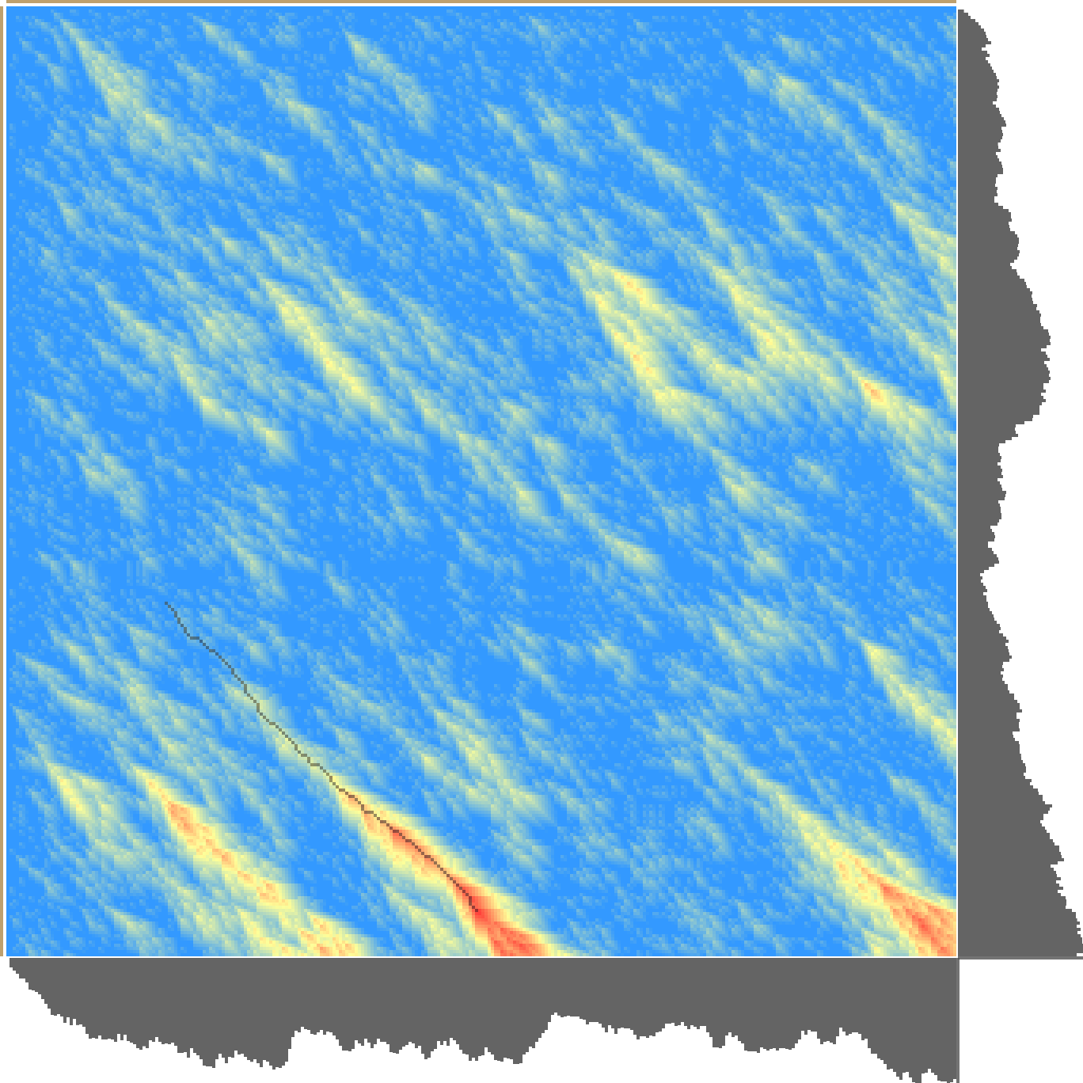
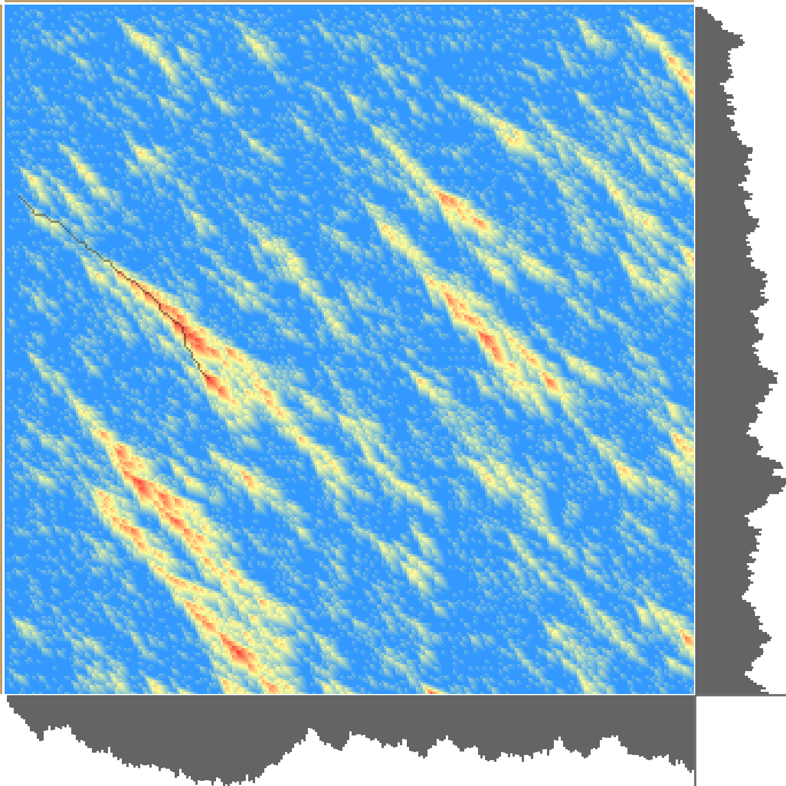
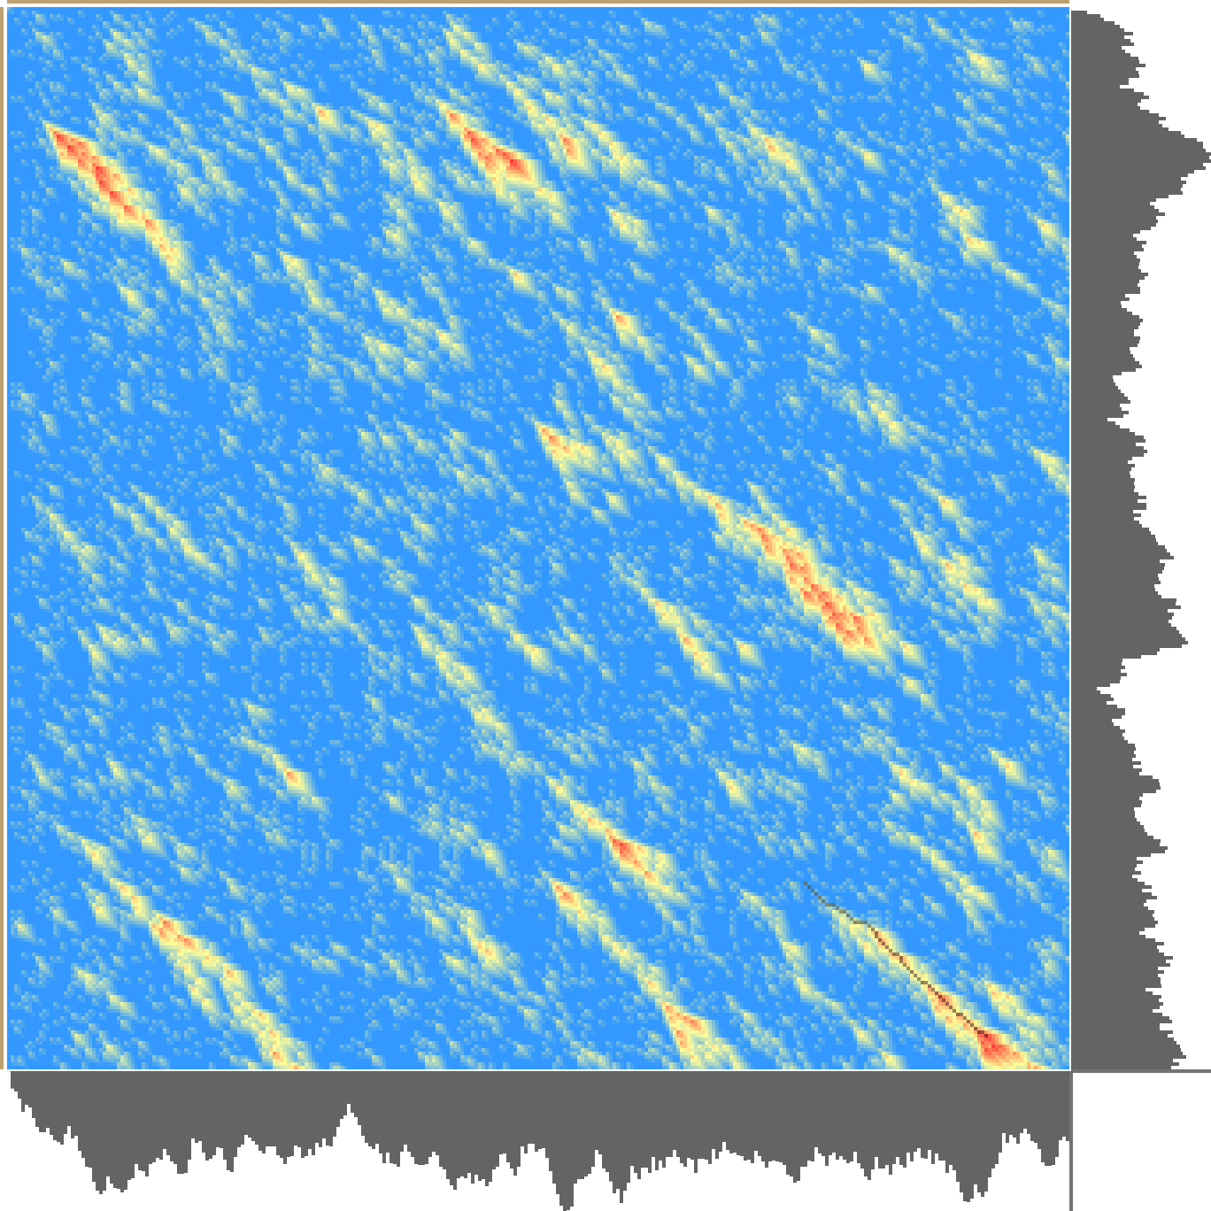
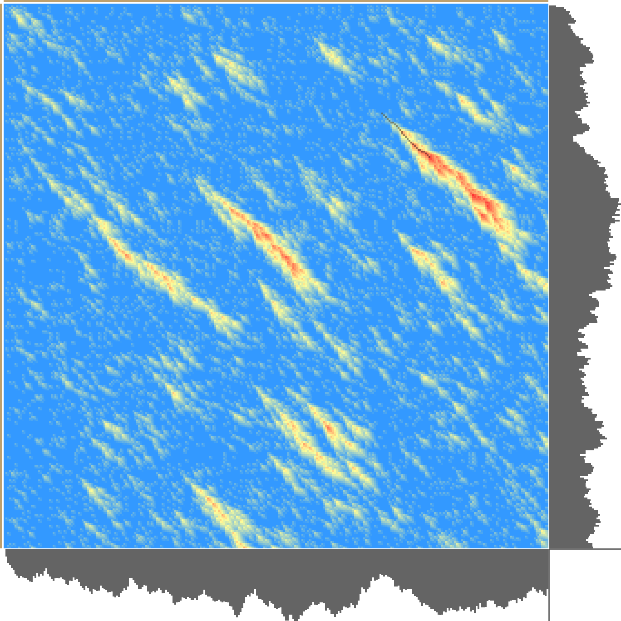
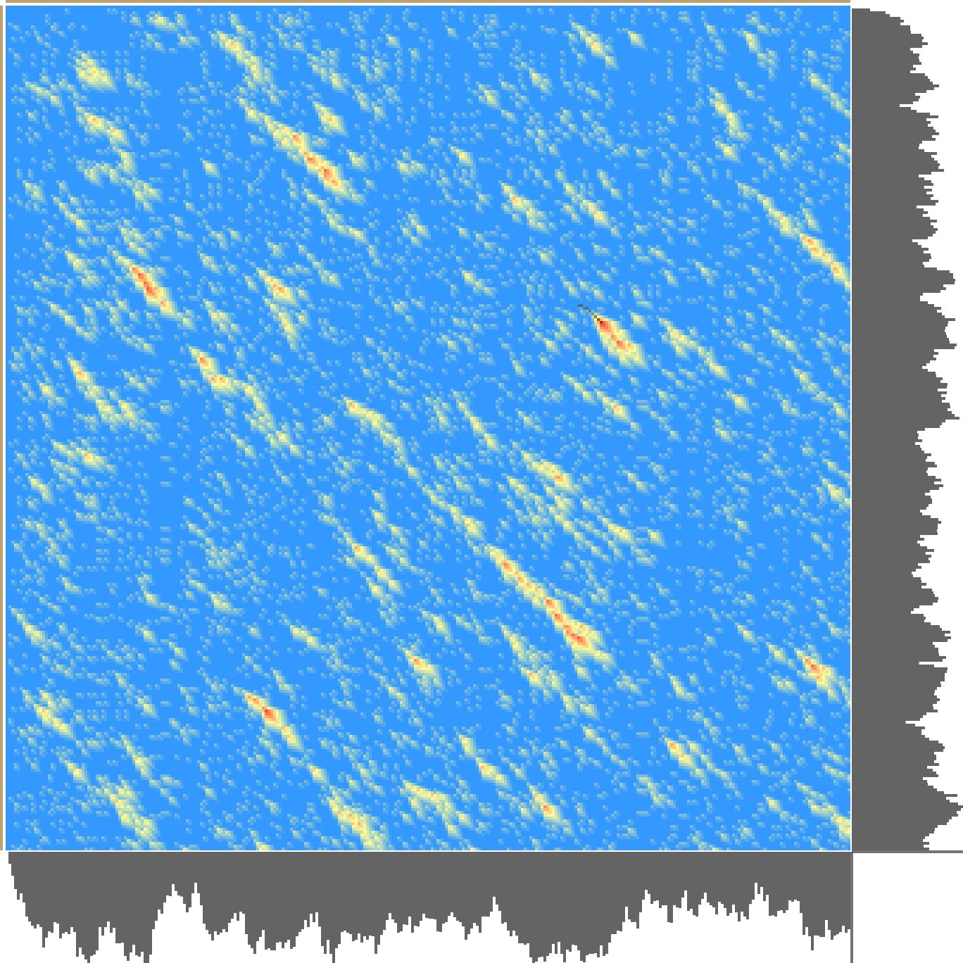
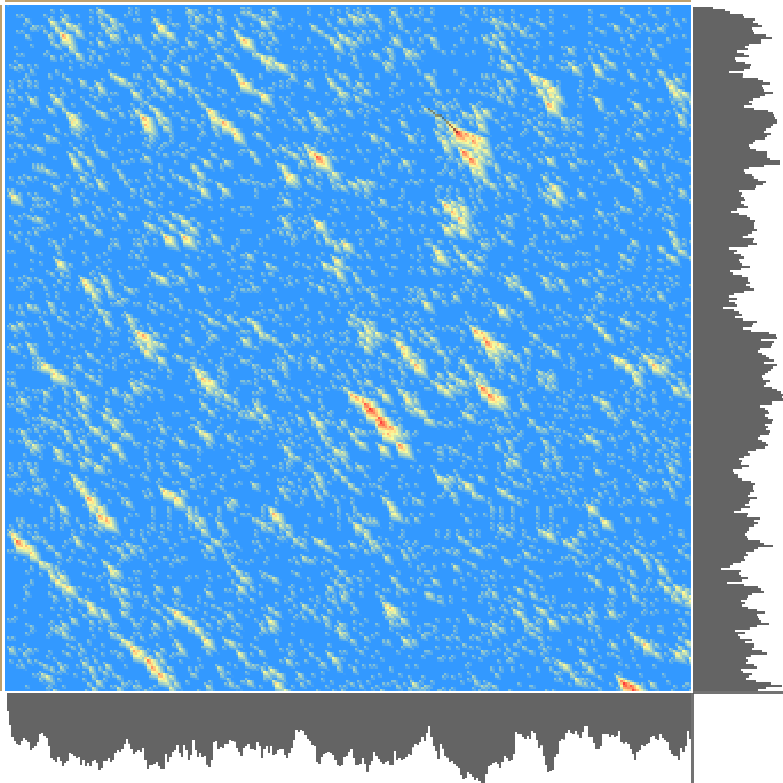
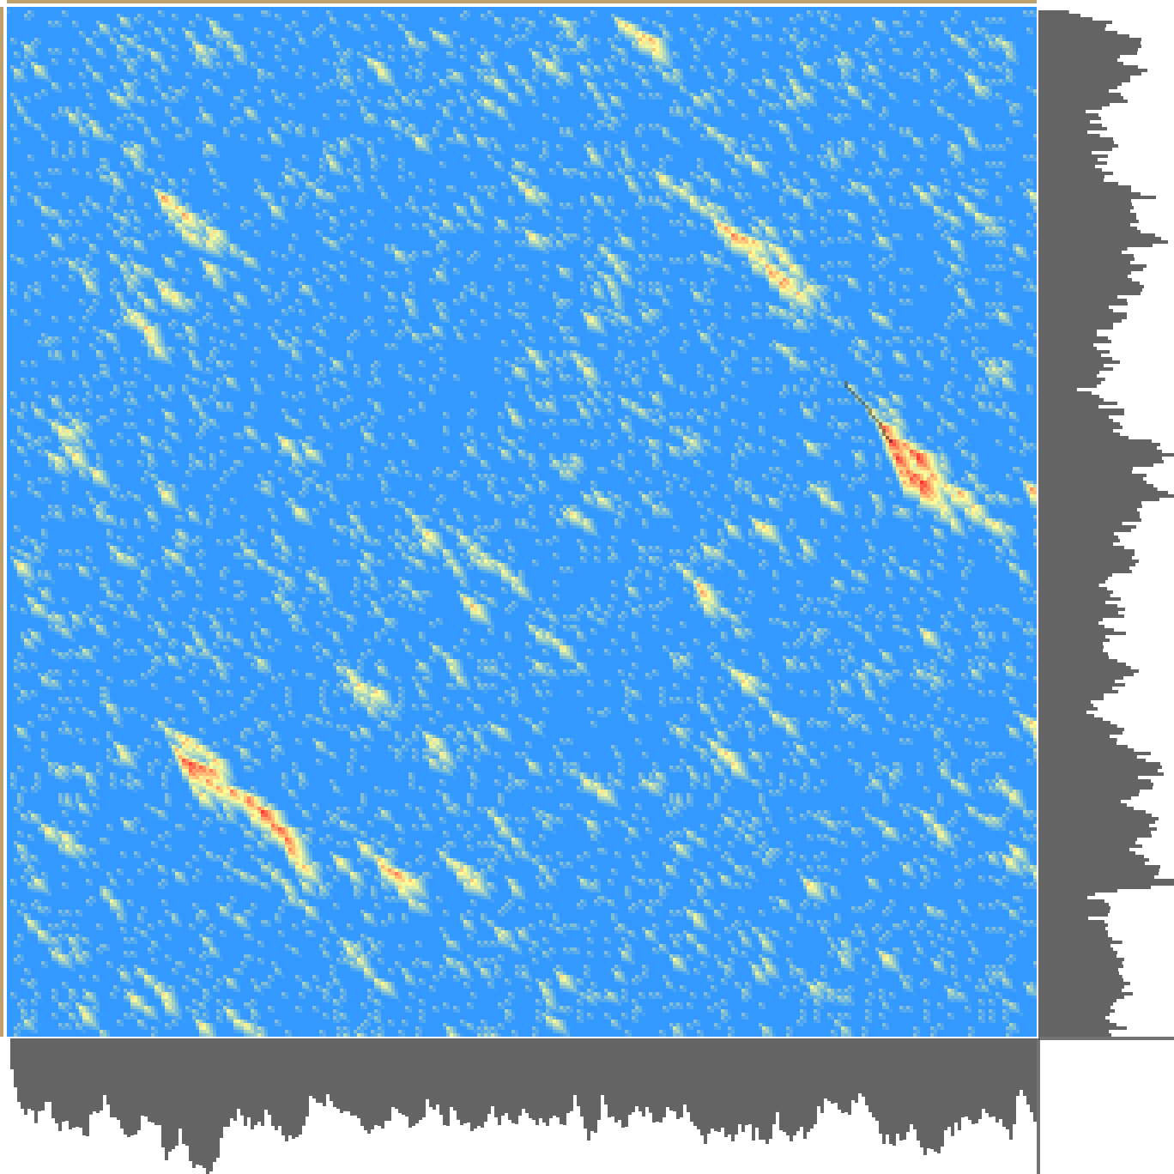
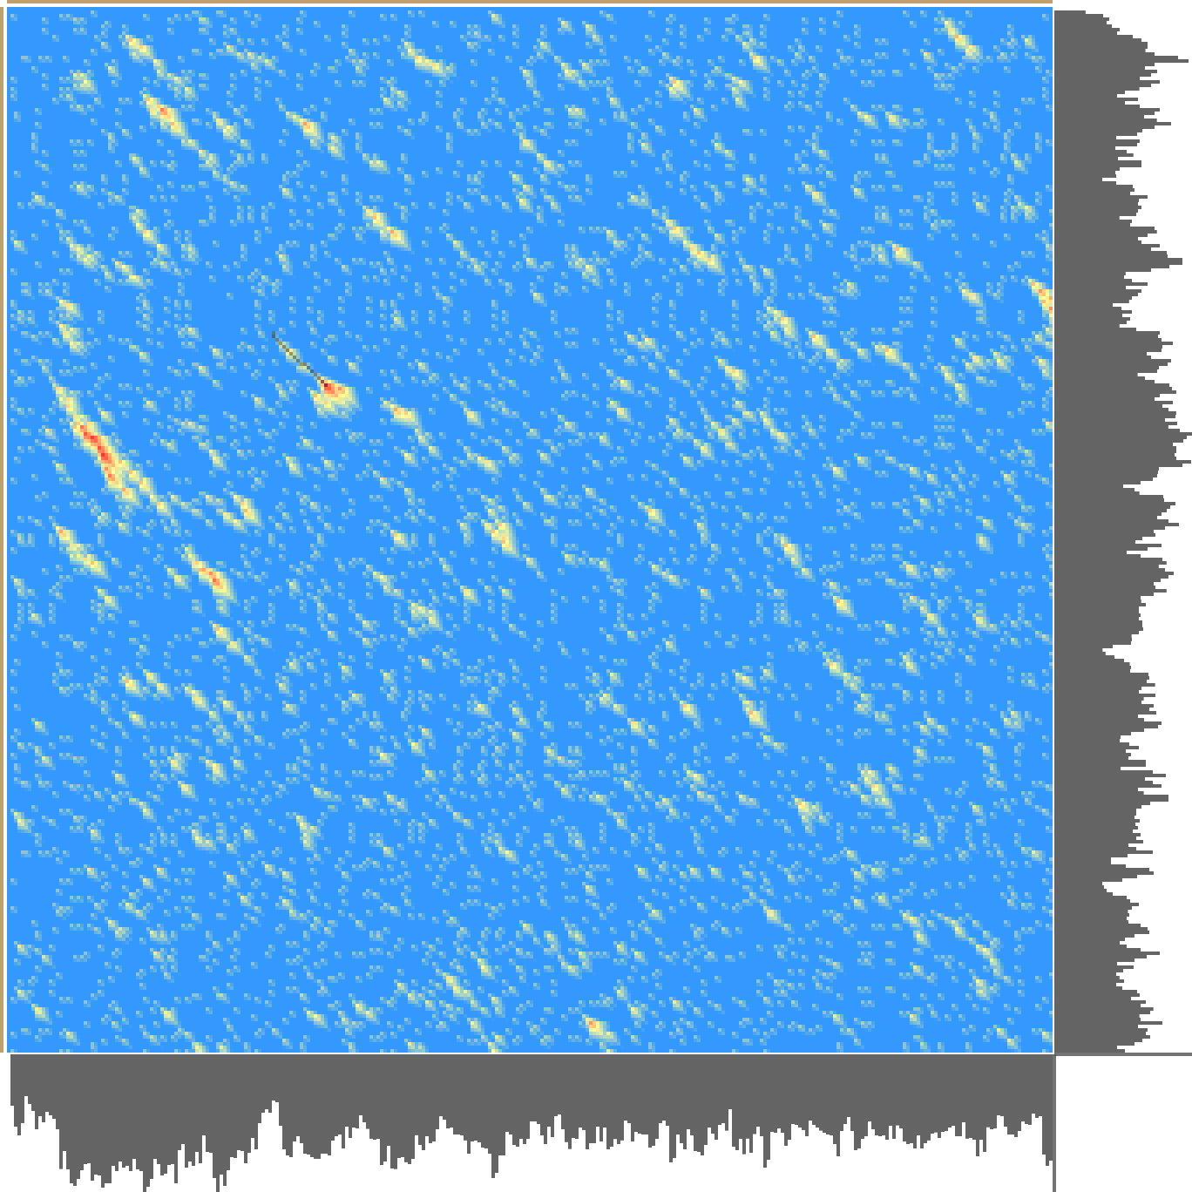
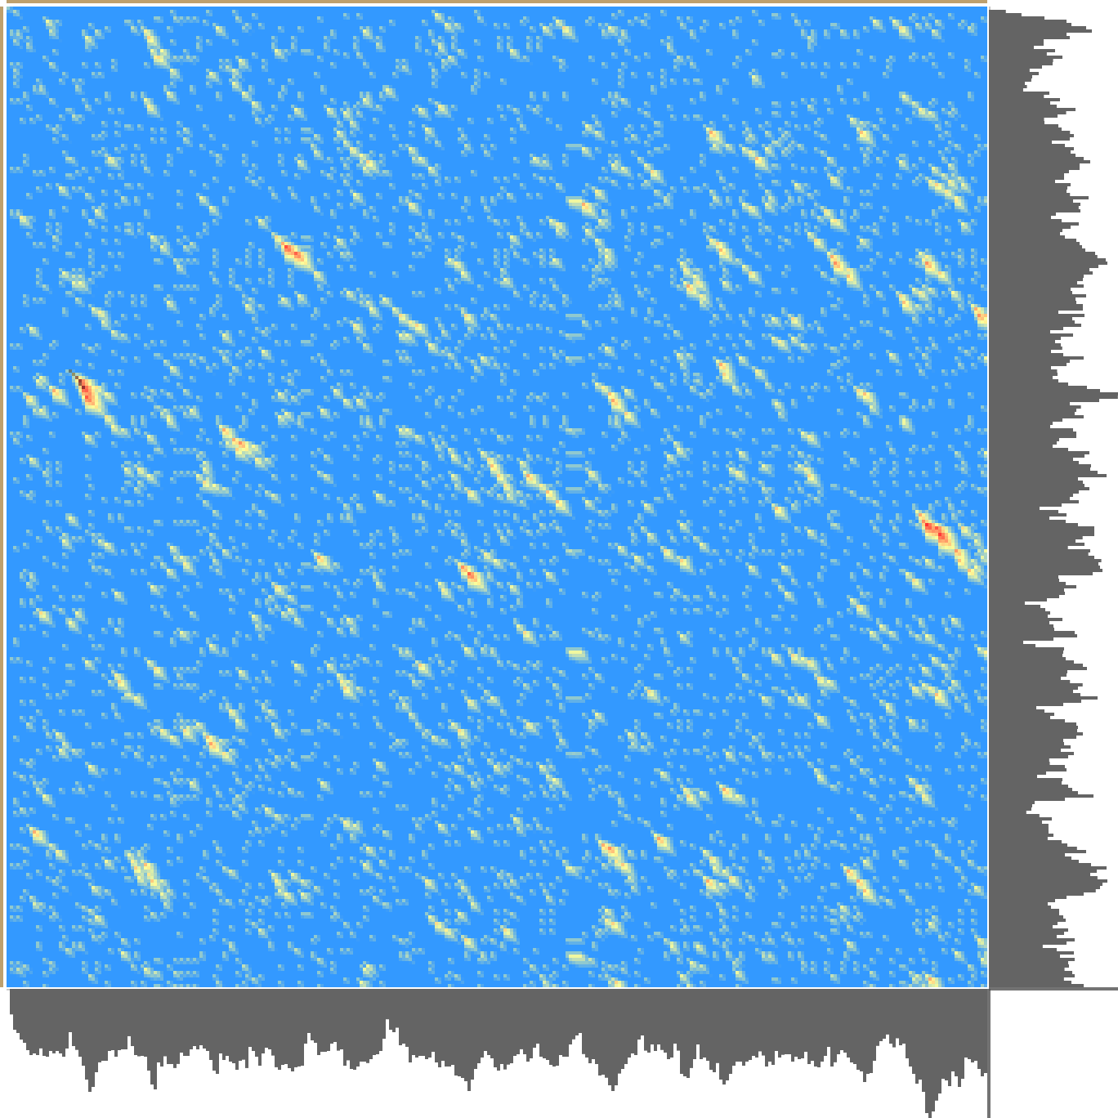
{A,B}
2×300 chr
α=[7], β=[-5], γ=[-10]
Random source: {ATCG} 2×300 chr
┏ 1b
5-[ TGGTA─AGCGTCGCCTGCA─TCATAGACTG─AC─AATCGCTA──GAC─AATT]-3
███ █ █ █████ █ ██ █ █ █ █ ██ ████ █ ███ █ █
5-[GGGGATTAGCGATTTAGACAGTACA─C──CGCCT─TAGTC─TTGTCAGAACGTGTCGCAAGGGACTGA─T]-3
┗ 1b
5-[TCTCGCGT──TAGCGCAGGGCGAGAC─C─G─CCGGCG─GCTGATTACGTGTACGCTATC─A─GCACAT─A]-3
███ ██ █ ██ █ ███ ██ ██ █ █ ██ ██ █ ██ █ ██ █ █ █ █ ██ █ █ █ █ █
5-[TCT─GC─TAATAATAC─GGG─GA─ACGCGGTCCCACGAGGTG─TGACATAT─TG─T─TCGACG─GCGTGA]-3
5-[─CTTCCGGGACGTG──CCTGCTTATAGACACAGTTTTCGGTA──GTAT─GC─CGA──GCGTGCT─T─GCA]-3
█ ██ ██ ███ ██ █ ██ █ ██ █ ██ ███ ██ █ ██ ██ ██ ███ ███ █ █
5-[GCCAGCGAGAAGTGCCCCGGATT─TGGA─ATAG─TTT─GGCACCAAATAGCGAGAGCGCGCGCTGTATTA]-3
5-[GGCGATCTCTCCG─CCCTCAG──CC─AACTTCGCGGA─GATTCAC─GTC─CCCCTCGACTCCTCTTGTC─]-3
██ ██ █ ███ █ ███ ██ █ ███ ███ █ ███ ███ ████ █ █ █ █ █ █ █
5-[GGTAAT─T─GCCGTCGGACAGTCCCTGATTTC─TGGACG───CACTGTCACCCCGC─A─T─CGC─AG─CA]-3
5-[ACTGTTCATTTCCGTA─GTCCAATGAC─CAGATACGTTAGCTGAGCAGCCCTAAAAGGA──ATCCGCGGA]-3
█ █ █ █ █ █ ██ ███ █ █ █ █ ██ ██ █ ██████ ███ █ ███ ██
5-[AAAG──GA─AT──G─AGGTGCAA─GTCTC─G─GACCTTTG─TGAGCA──CCTGGAGGGATTAT]-3
{A,B,C}
2×300 chr
{A,B,C,D}
2×300 chr
(d)
(b)
{… C,D,E}
2×300 chr
Based on a Random Number Generator
{… D,E,F}
2×300 chr
α=[7], β=[-5], γ=[-10]
Random source: {ATCG} 2×300 chr
{… E,F,G}
2×300 chr
┏ 1b
5-[ATTTTAACAC─CCAAATAT─CT─TC─A──CATTTT─CTATTCTACTTA─CAT─ATCCACTA─CTCAACAA]-3
██ ██ ██ ██ █ ██ ██ █ █ ████ █ ███ ██ ███ █ █ ██ █ ██ ███ █ █
5-[ ACCAA─ACTCCTAACCTCCTATCAACTCTTTTTCCAATTATA─TTACCCTCAT──AATATCTC──C─A]-3
┗ 1b
5-[TTA─CCCTACATCCCAT─ACATTAAC─ATTCCTAACCACACT─TTCTCTCTACACCTACA─ACAATTCTA]-3
███ ██ █ ██ ██ ███ █ █ ███ ███ ███ ███ ███ ███ ████ ███ ██ █ █ ██
5-[TTATCCATTCA──AAATCTCATCACCTATT─CTATCCA─ACTCCTCT─TCTTCACCAACATAC─A─T─TA]-3
5-[TTCTTTAAA─TC─TAT─CATTTTTTA─TA─ATCCCATCT─ACCTAAAAC─ATACAATT───AACTAACCC]-3
██ ███ ██ ██ ███ █ ██ ██ ██ ████ ███ █ ██ ██ █ ██ ██ ██████
5-[ATC───AAATTCACATACATAATATACTATATATTATCTAACCCCATACAATCCCCTTCCCAA─TAACCC]-3
5-[T──ATACTATATTTATCAAAAAATTACCCCCTCCCCCCAATTAAACTTCTAAAATA─CATA─ACATT─CA]-3
█ █████ █ ████ ██ ███ ██ █ █ █ ██ ████ █ █ █ ██ ██ █ ██ █ ███ ██
5-[TACATACT─T─TTTA─CATAAACTT──CACAT──AACC─ATTATA─TACCCAACTATC─TACA─ATTACA]-3
5-[CTACC─TATTA─T─ACTTAATTATACAA─ACACACCTCTCCACCCACAACCCTC]-3
█ ██ █ ██ █ ████ ██ █ ███ █████ █ █ ██ █ ████
5-[C──CCAAAATATTCCCTTACTTTTCCAATACACA─ATATTAACTC─CAACTTATTT]-3
(e)
{… F,G,H}
2×300 chr
α=[7], β=[-5], γ=[-6]
α=[7], β=[-5], γ=[-7]
{… G,H,I}
2×300 chr
(c)
Based on a Markov Chains Generator
{… H,I,J}
2×300 chr
{… K,L,M}
2×300 chr
{… L,M,N}
2×300 chr
{… M,N,O}
2×300 chr
{… N,O,P}
2×300 chr
{… O,P,Q}
2×300 chr
α=[7],
β=[-5],
γ=[-10]
(f)
(a)
┏ 1b
5-[AAAAAAAAATTTTTTTTTTAAAAAAAAAAAA]-3
█████████ ████████████
5-[AAAAAAAAA──────────AAAAAAAAAAAA]-3
┗ 1b
┏ 1b
5-[AAAAAAAAATTTTTTTTTTAAAAAAAAAAAA]-3
████████████
5-[ AAAAAAAAAAAAAAAAAAAAA]-3
┗ 1b

Slide 2


True randomness and chaos
True randomness and chaos. (a) Shows a series of heatmaps from experiments made on random sequences of 300 characters, each built from a different alphabet. The components of the alphabet are embedded in braces and are displayed next to each heatmap. The three dots inside the braces represented all the letters starting from letter "A". Note that the increase of the number of components/letters of an alphabet leads to a visible decrease in the number of matches made by pure chance. (b) an alignment of two random sequences of 300 characters based on a random number generator, (c) and an alignment of two random sequences of 300 characters based on a Markov Chains Generator. Note the difference between the two heatmaps: In (b) the image shows a pattern closely related to the observed structure of regular biological sequences, while in (c) the image shows a pattern different from that expected from biological sequences. The top right corner in (b) and (c) shows the contour features of the image from the heatmap. (d) shows an alignment starting from a specific cell and a regime change (e) started from a neighboring cell. A switch between the two neighboring cells induces completely different results. Thus, (d) and (e) indicate a degree of nonlinearity. (f) A nonlinear behavior in the normal regime of local alignment. A small change in the parameter values (±1 in γ) causes a drastic change in the traceback start location.
Cite this work as:
Paul A. Gagniuc. Algorithms in Bioinformatics: Theory and Implementation. John Wiley & Sons, Hoboken, NJ, USA, 2021, ISBN: 9781119697961.

